Slide 1



Innovative approaches for teaching statistics in higher education
Craig Alexander & Eilidh Jack (University of Glasgow)

Slide 2
Introduction
Statistics as a discipline is ever evolving. Our teaching methods should also reflect this changing environment.
Pedagogical advances over the recent decades allow us to expand our teaching beyond the classic classroom lecture.
Technology assisted learning has also improved greatly over the past years, allowing the facilitation of several teaching aids and online learning.

Slide 3
Introduction
These advances not only apply to our teaching delivery but can be incorporated into a variety of assessment styles.
In this talk, we will consider several case studies from courses at the University of Glasgow which implement modern teaching methods as part of their delivery.

Slide 4
Case study 1– Data Analysis Skills
An M-level skills-based course covering modern techniques in data analysis and soft skills in presentation and report writing.
New techniques are introduced in the course, such as scraping data from the web and collaborative coding.
Course is delivered as a flipped classroom: students are provided the materials at the beginning of the week, then come to the classroom to review and practice.

Slide 5
Case study 1– Data Analysis Skills
A flipped learning approach has several benefits:
Students can learn at their own pace.
More efficient as students enter the lecture room prepared.
Makes lectures more enjoyable, productive and engaging.
Doing exercises in class allows students to work together.

Slide 6
Case study 1– Data Analysis Skills
Lectures consist of a short review of materials followed by in-class exercises, using a mixture of individual and group-based activities. Tools such as Mentimeter allow for real-time voting for questions in class.
A mixture of assessment styles are used within the course, including group-based activities which facilitate project-based and collaborative learning.
Group projects typically involve a data analysis project with a verbal presentation and incorporate tools such as collaborative coding.

Slide 7
Case study 1– Peer review
Peer review is an active learning tool which allows students to provide feedback on their peers work.
It has several learning benefits such as internal feedback, critical thinking and problem solving.
Peer review is a tool that is not often used within statistics education.

Slide 8

Case study 1– Peer review
The activity involves students sourcing and scraping their own data and constructing a research question and statistical analysis plan.
Students then submit their work via a peer review platform (e.g., Aropa) and are assigned fellow students work to review using a rubric provided by the course lecturer.

Slide 9
Case study 1 – peer review
A small study was conducted into students' perceptions of peer review (Low et al., 2022) in terms of their perceived learning.
From the survey, students felt the exercise contributed to their learning experience, particularly comparing peers work against their own & contributing moderately over what a teacher could provide.
In the open questions at the end of the questionnaire, several students mentioned that it would be helpful to have seen the teacher’s feedback on the same piece of work to allow them to compare with the feedback they gave.

Slide 10
Case study 2 – Level 1 statistics
Our introductory courses for undergraduate students adopt similar approaches to those discussed in Data Analysis Skills (using flipped learning approaches)
Interactive R labs have been added to the course, using the webexercises package developed by the psyTeachR team at the University of Glasgow
These labs allow students to work through the lab materials at their own pace, outside the classroom. Interactive quiz questions are included to help students consolidate their learning

Slide 11
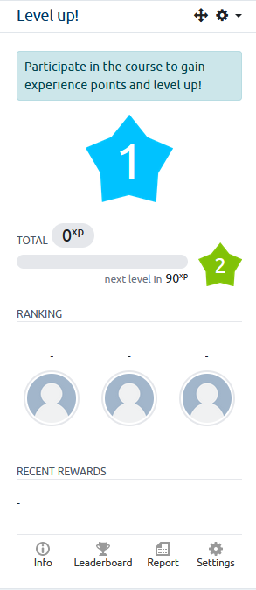
Case study 2 - Level up!
Participate in the course to gain experience points (xp) and level up!
Points are awarded for participation in course via Moodle.
Aim to get to level 10 by the end of the course.
Endeavour based not merit based.
Prizes awarded at the end of the course for:
Top 3 students.
Best team (based on tutorial groups).

Slide 12
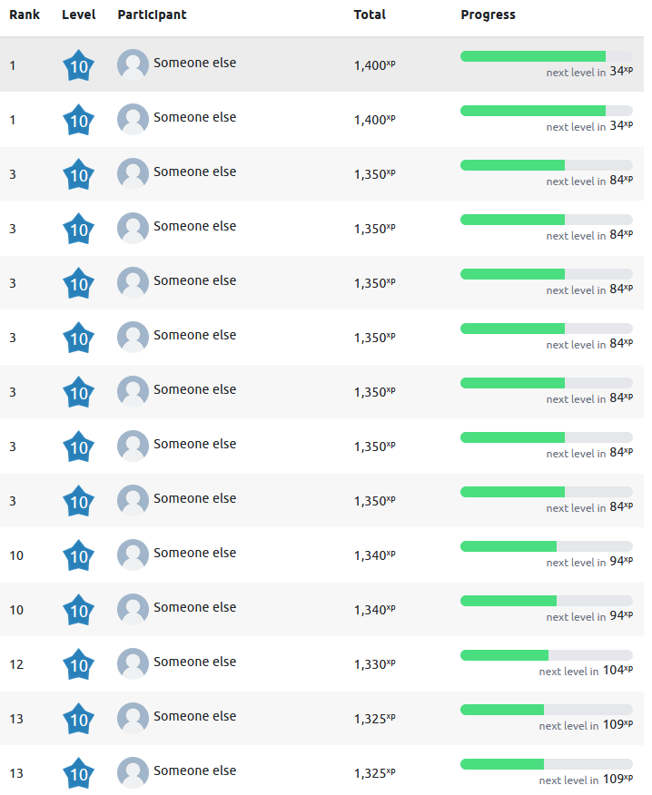
Case study 2 - Level up! Reflections
Interaction has been better than expected.
Informal feedback: 61% of students say “Level-up makes me more likely to engage in the course”.
Increased activity completion compared to semester 1 (median increase of 31%, mean increase of 14%).
Going to have to buy a lot of prizes.

Slide 13
Case study 3 – Teaching programming courses
Statistical programming forms a key part of any statistics degree, and with the growing popularity of data science, industry roles require graduates to have a firm grasp of programming concepts.
At Glasgow, we currently have a variety of programming courses, delivered in-person and as part of our online distance learning degrees.
Though the programming language and techniques differ across these courses, many of the teaching practices used are shared across all courses.

Slide 14
Case study 3 – Teaching programming courses
Programming courses have evolved over time, with the removal of a traditional lecture, and a flipped learning approach adopted.
Concepts and examples are introduced to students to study independently, with a practical lab consisting of exercises delivered as the in-person taught component, utilising a problem-based learning approach.

Slide 15
Case study 3 – Teaching programming courses
Tools such as Google Colabs and Jupyter notebooks are also used for independent student learning, allowing integration of text and code in one document, which students can run using a web browser.
Assessment structure in programming courses can be varied, using timed quizzes, take-home exercises and using collaborative coding tools such as GitHub for group projects.

Slide 16
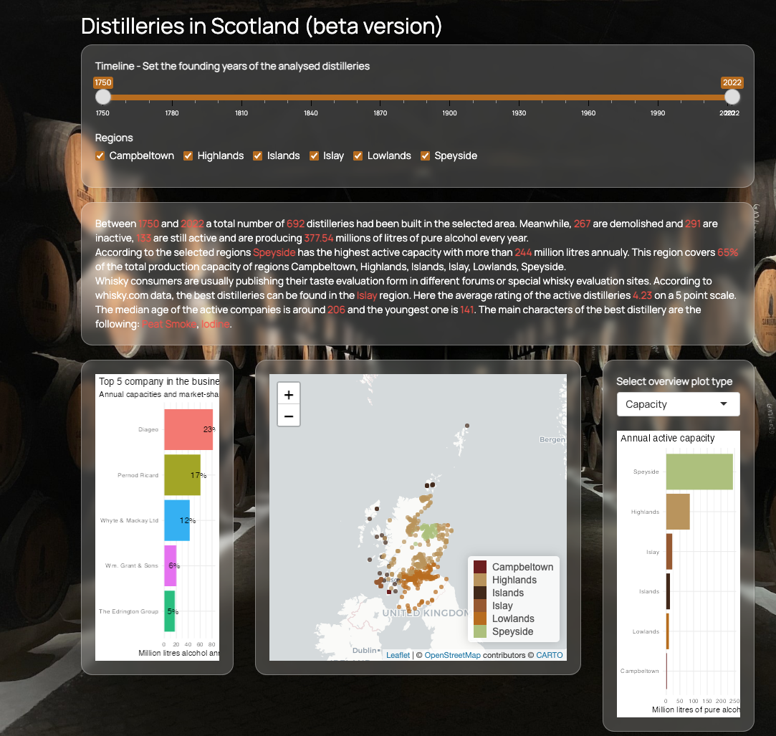
Case study 3 – Teaching programming courses
In our online R course, the final project for students involves constructing a Shiny app for a set activity.
This project incorporates elements of the full course, allowing a full review of the materials covered.
Well received by students (once completed!). Can be time consuming to mark.

Slide 17

RSS Teaching statistics group
The RSS Teaching Statistics Section is targeted to statistics educators working in post-18 education.
The group aims to promote good teaching practice across post-18 education, promoting the study of statistics to students, facilitating the discussion of modernizing the statistics curricula and promoting innovative use of technology in teaching statistics.
You can sign up for our newsletter detailing the latest teaching statistics events at our website.
If you would like to contribute to our newsletter or have ideas for events you would like to see, please get in touch via teachingstats@rss.org.uk.
You can find us on Twitter @rss_teach

Slide 18
Thank you!
Any questions?

